Slide 1



Slide 2


HI , I’m Colin McNamara
Entrepreneur: Co-founder of Always Cool Brands, focusing on private-label products and health-conscious goods (LangChain User)
Co-Founder of Austin LangChain AIMUG: An 1100+ member AI community in Austin.
10% Developer: Former Oracle Cloud Infrastructure lead with experience in hyper-scale cloud building, operations, engineering, and design.
Public Good: Helping our community succeed
LinkedIn:

Slide 3
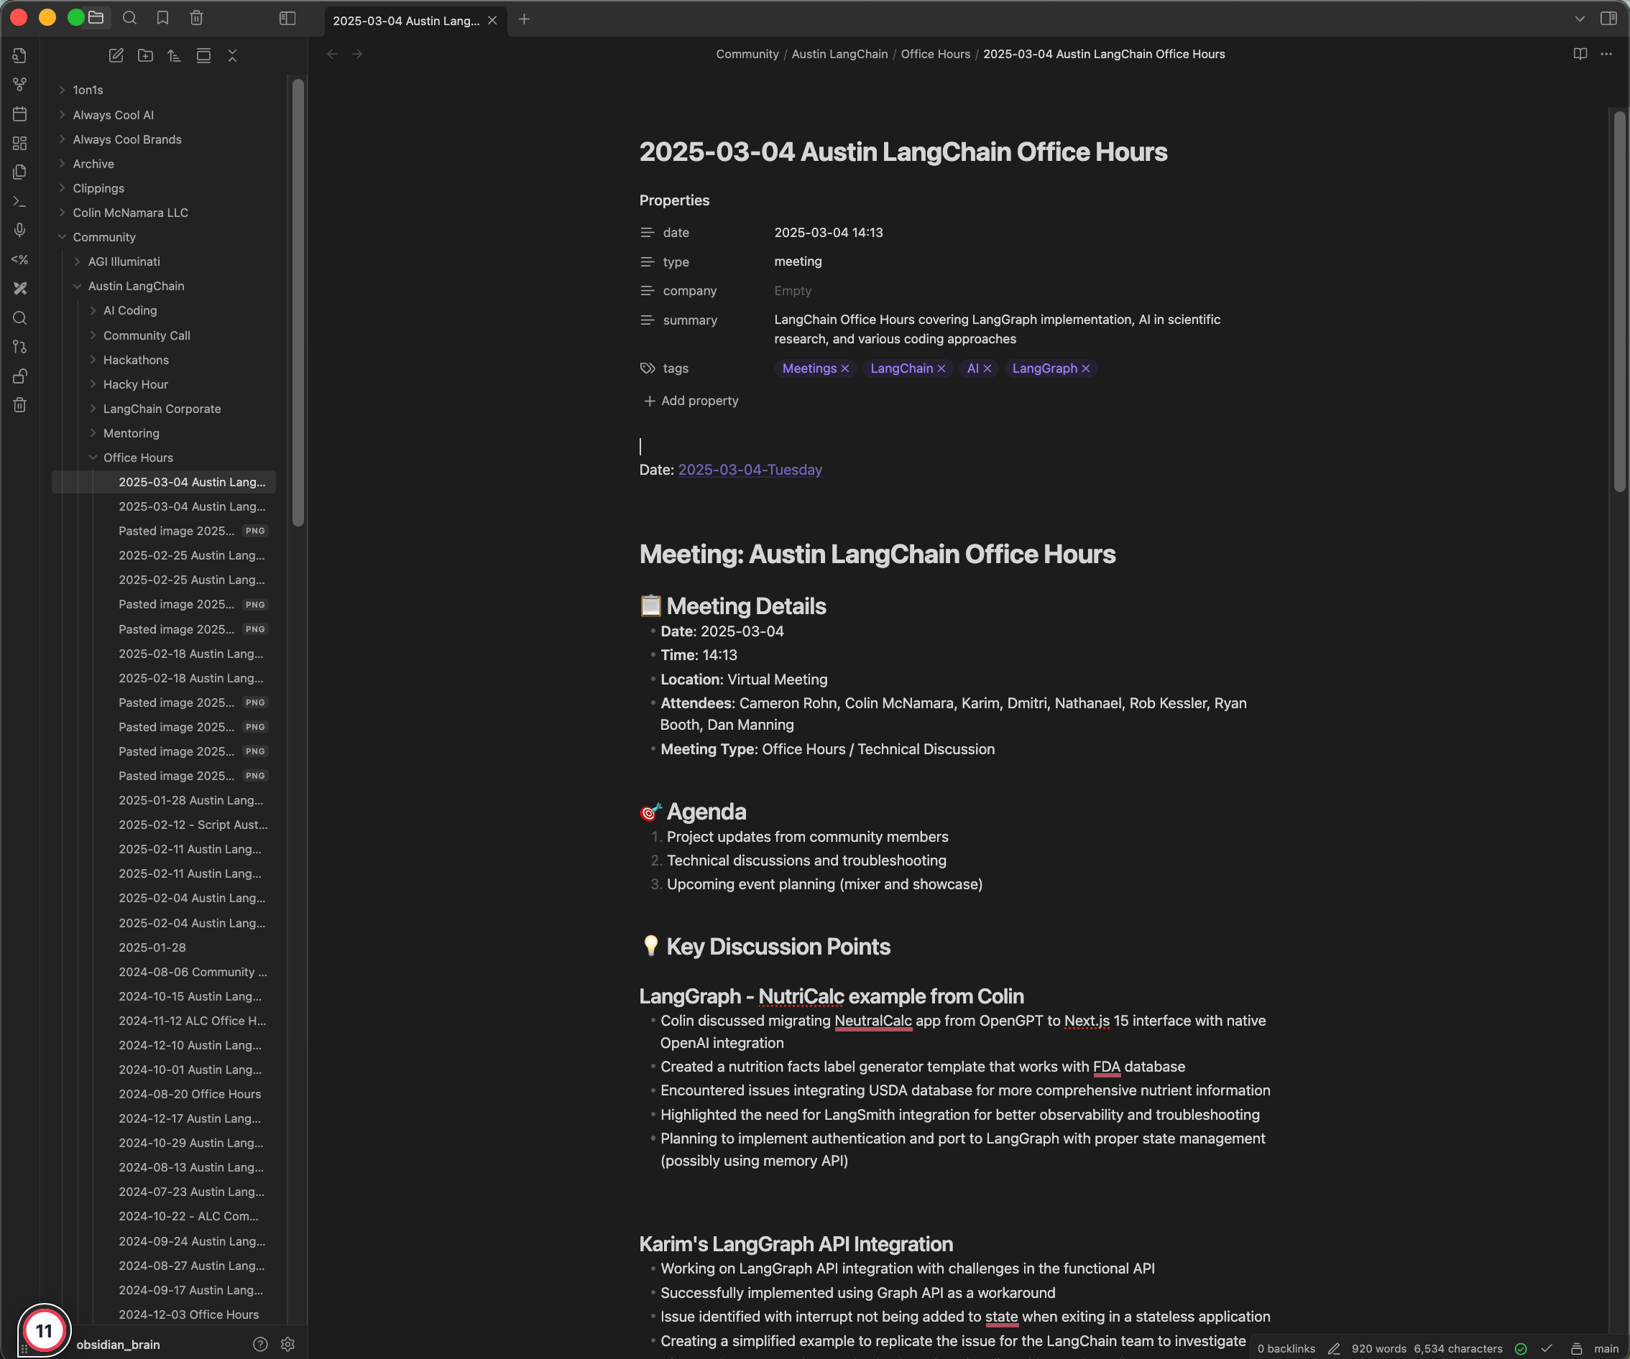
I love obsidian

Slide 4
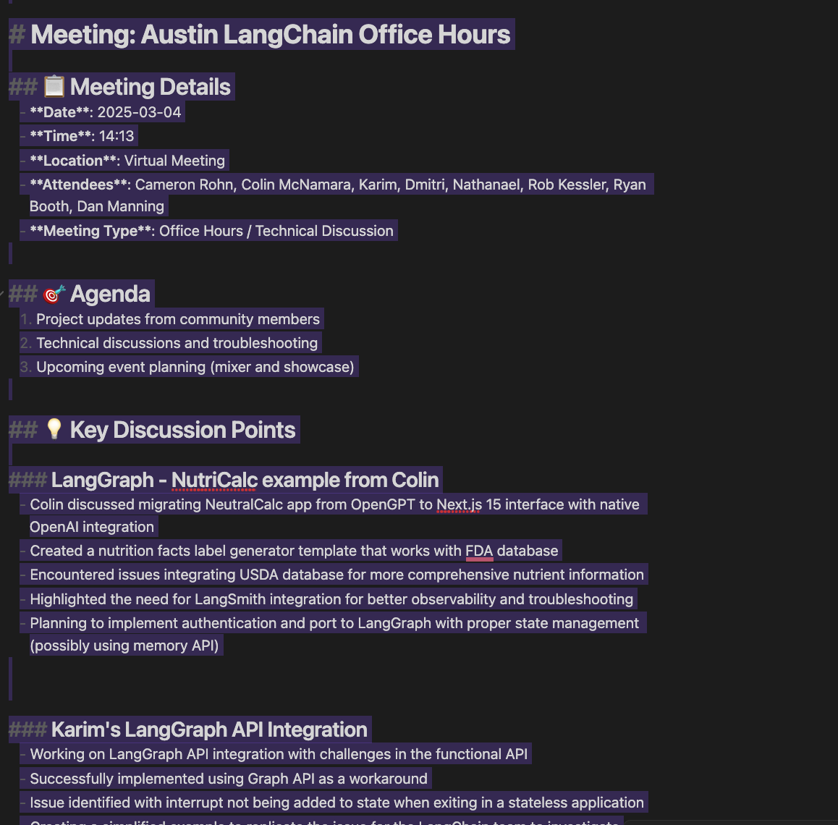
Why I love obsidian – Markdown
Markdown Based:
Plugin : Learning AI through the Lense of LangChain, pulling the ecosystem together.
Engaged, Active Attendees: A mix of local innovators, enthusiasts, and early adopters.
Supportive & Engaged Community: A well-balanced Discord that’s "useful, but not overwhelming."

Slide 5
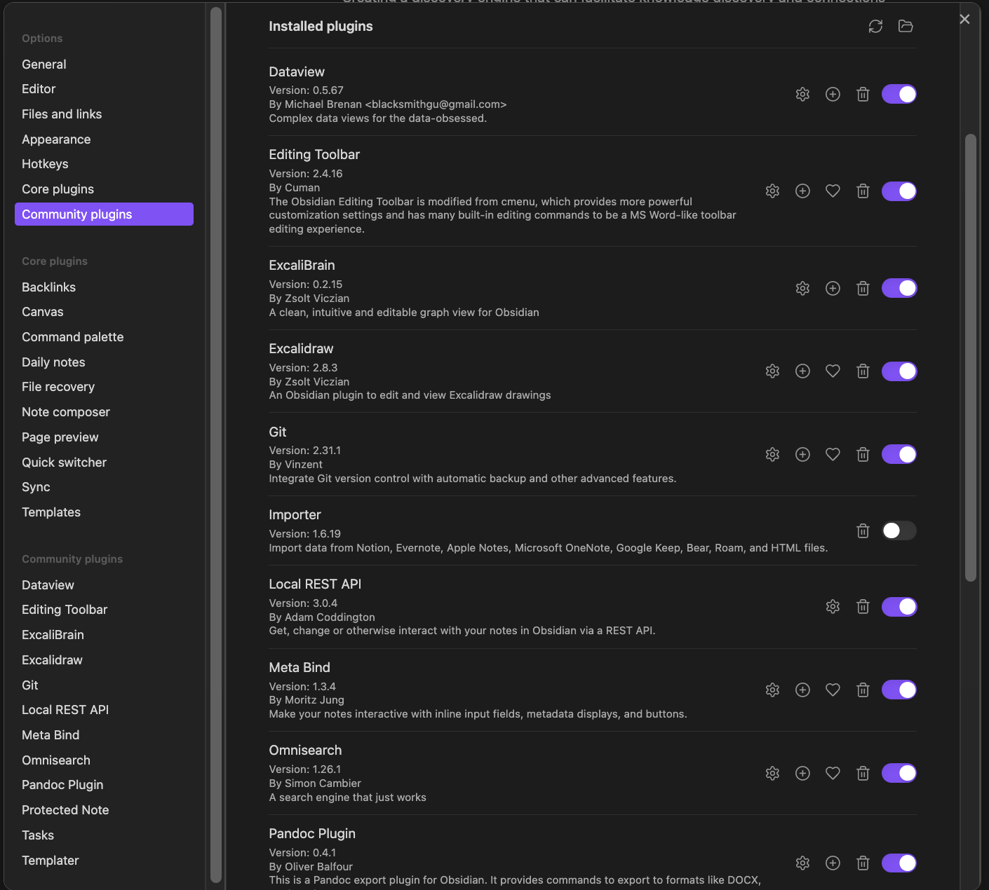
Why I love obsidian – Plugins
Markdown Based:
Plugin : Learning AI through the Lense of LangChain, pulling the ecosystem together.
Engaged, Active Attendees: A mix of local innovators, enthusiasts, and early adopters.
Supportive & Engaged Community: A well-balanced Discord that’s "useful, but not overwhelming."

Slide 6
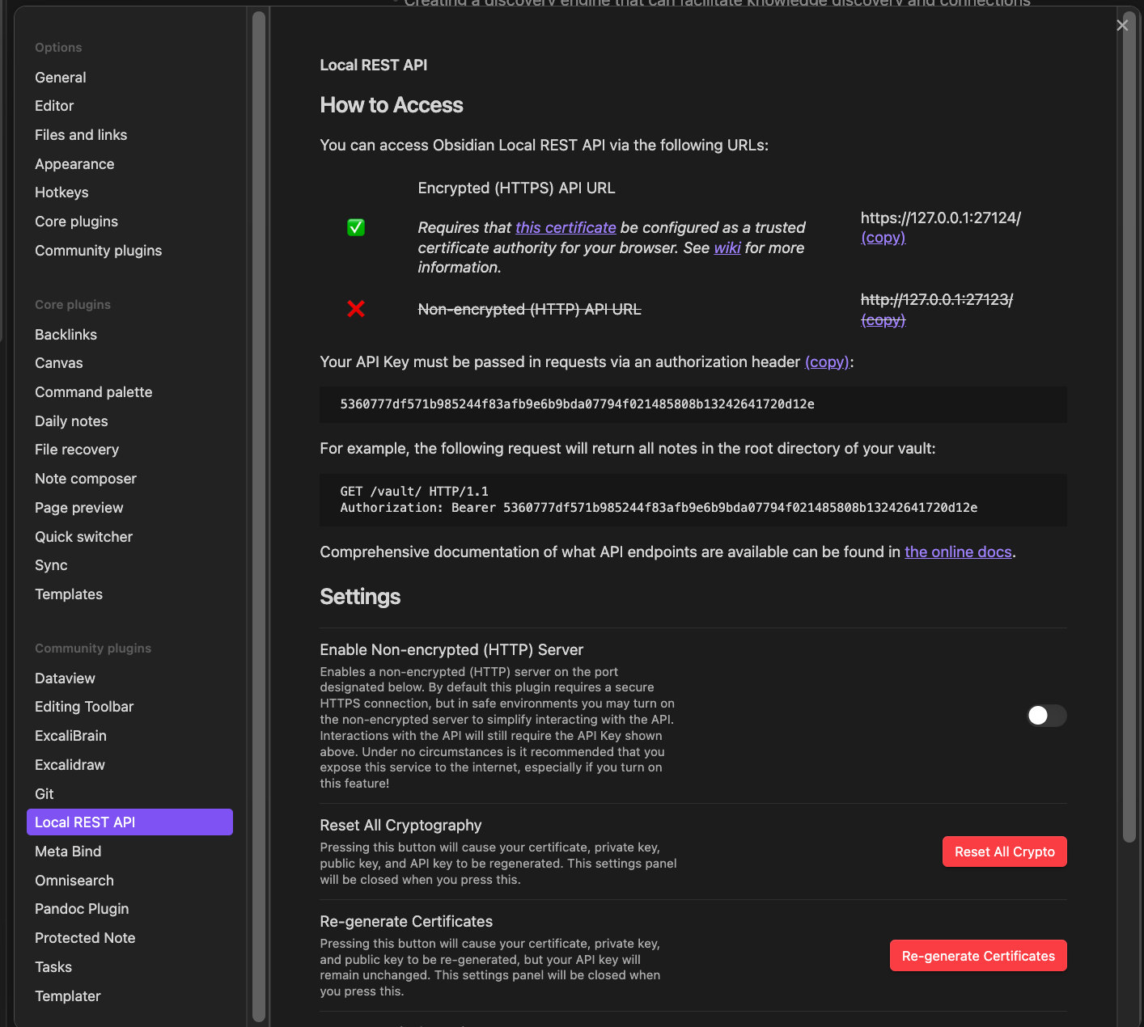
Why I love obsidian – API
Markdown Based:
Plugin : Learning AI through the Lense of LangChain, pulling the ecosystem together.
Engaged, Active Attendees: A mix of local innovators, enthusiasts, and early adopters.
Supportive & Engaged Community: A well-balanced Discord that’s "useful, but not overwhelming."

Slide 7
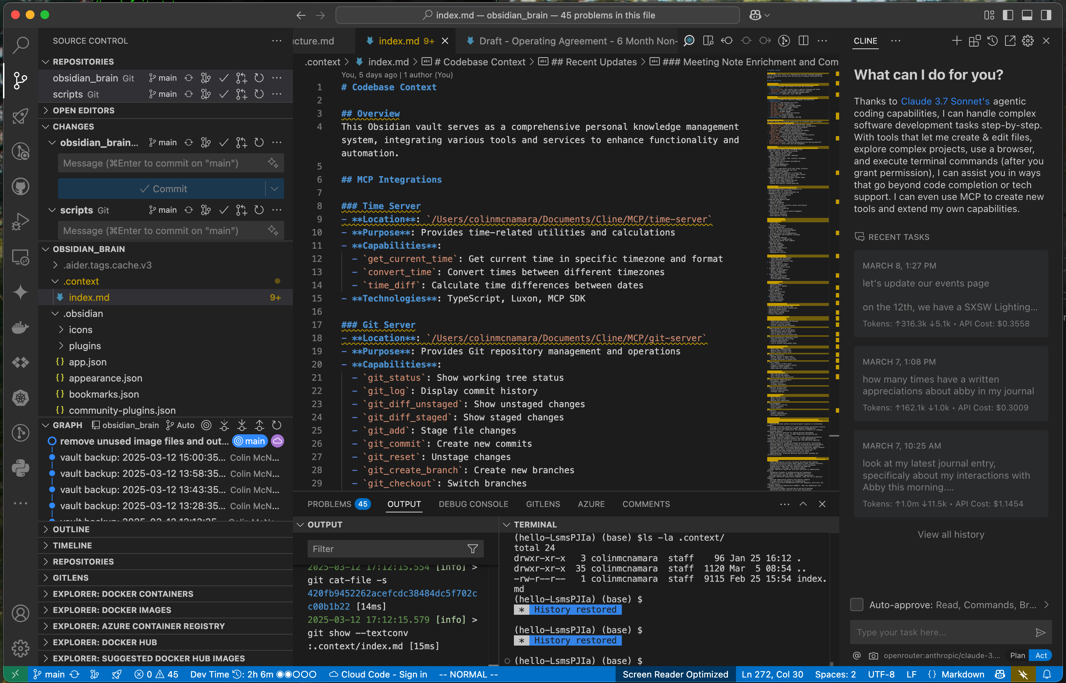
Why I love obsidian – VSCODE
Markdown Based:
Plugin : Learning AI through the Lense of Lanhain, pulling the ecosystem together. gC
Engaged, Active Attendees: A mix of local innovators, enthusiasts, and early adopters.
Supportive & Engaged Community: A well-balanced Discord that’s "useful, but not overwhelming."

Slide 8
Why I love obsidian – Plugins
Markdown Based:
Plugin : Learning AI through the Lense of LangChain, pulling the ecosystem together.
Engaged, Active Attendees: A mix of local innovators, enthusiasts, and early adopters.
Supportive & Engaged Community: A well-balanced Discord that’s "useful, but not overwhelming."

Slide 9
Why I love obsidian – Plugins
Markdown Based:
Plugin : Learning AI through the Lense of LangChain, pulling the ecosystem together.
Engaged, Active Attendees: A mix of local innovators, enthusiasts, and early adopters.
Supportive & Engaged Community: A well-balanced Discord that’s "useful, but not overwhelming."

Slide 10
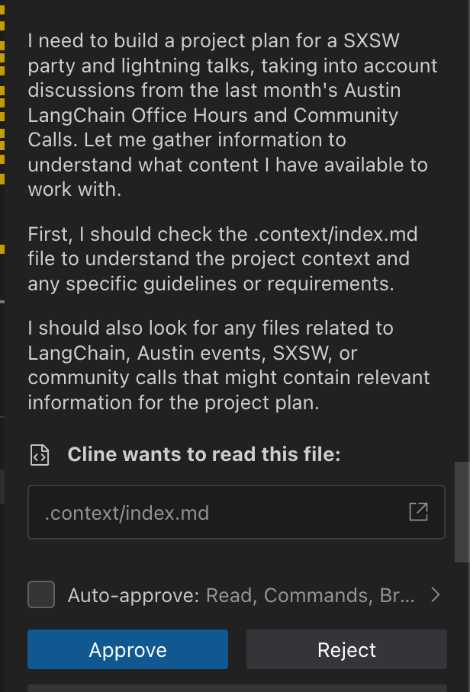
Why I love obsidian – CLINE

Slide 11
I love obsidian

Slide 12
Who we are – Austin LangChain AIMUG
1100+ Members Strong: Connecting Austin’s tech, creative, and business leaders passionate about AI.
Learning in the Open: Learning AI through the Lense of LangChain, pulling the ecosystem together.
Engaged, Active Attendees: A mix of local innovators, enthusiasts, and early adopters.
Supportive & Engaged Community: A well-balanced Discord that’s "useful, but not overwhelming."

Slide 13
Learning in the Open – "Be Cool to Each Other" ✌️
Respect & Inclusivity: Our only rule is simple: “Be cool to each other, don’t be gross.”
AI Enthusiasts of All Levels Welcome: We celebrate diverse perspectives and unique paths in AI.

Slide 14
Where and when we meet 🌟📅
Monthly Showcases & Mixer - ACC RGC3000: Community members and vendors share projects, demos, and labs for hands-on learning.
Hacky Hours (Mid-Month) - Rotating Local Bars: Informal happy hours at local spots; meet, discuss, and relax.
Weekly Virtual Syncs - Online: Tuesdays & Thursdays at 2 PM – Workshopping, problem-solving, and AI discussions.
Weekly Virtual Syncs - Online: Tuesdays & Thursdays at 2 PM – Workshopping, problem-solving, and AI discussions.
Schedules: Meetup, lu.ma, aimug.org

Slide 15
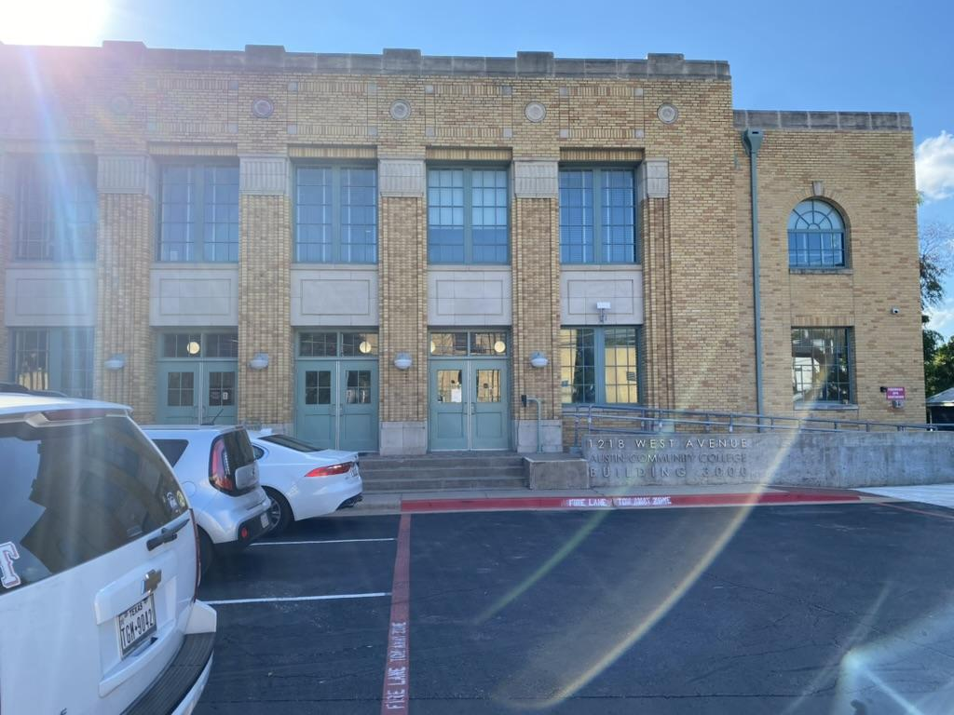
Finding US - ACC RGC-3000

Slide 16
Special Thanks
Venue Sponsor: CloudFlare
Pizza Sponsor: LangChain AI
Beverage Sponsor: Always Cool Brands
Volunteers: Austin LangChain AIMUG
Presenters:

Slide 17
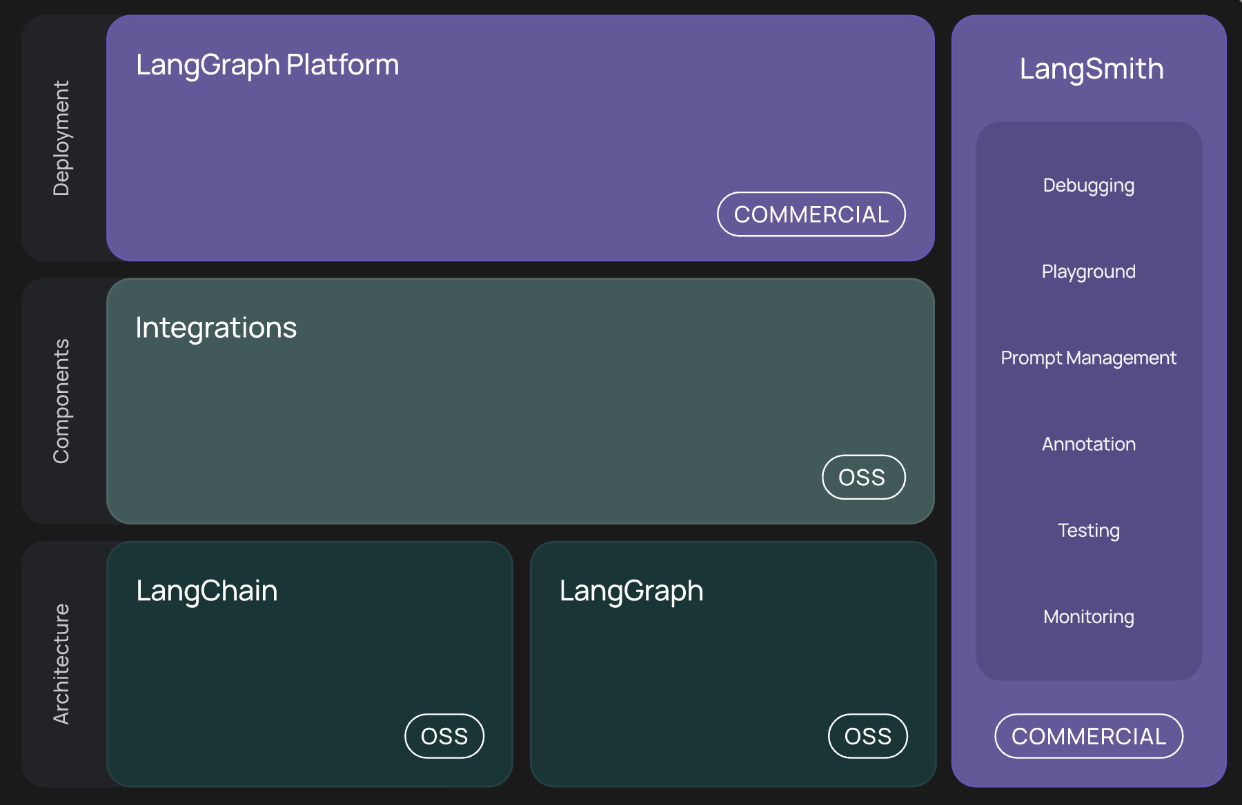
What’s LangChain

Slide 18
Special Thanks

Slide 19
Student Showcase

Slide 20
MCPs on CloudFlare

Slide 21
MCP + Open-WebUI + Pipelines + LangGraph

Slide 22
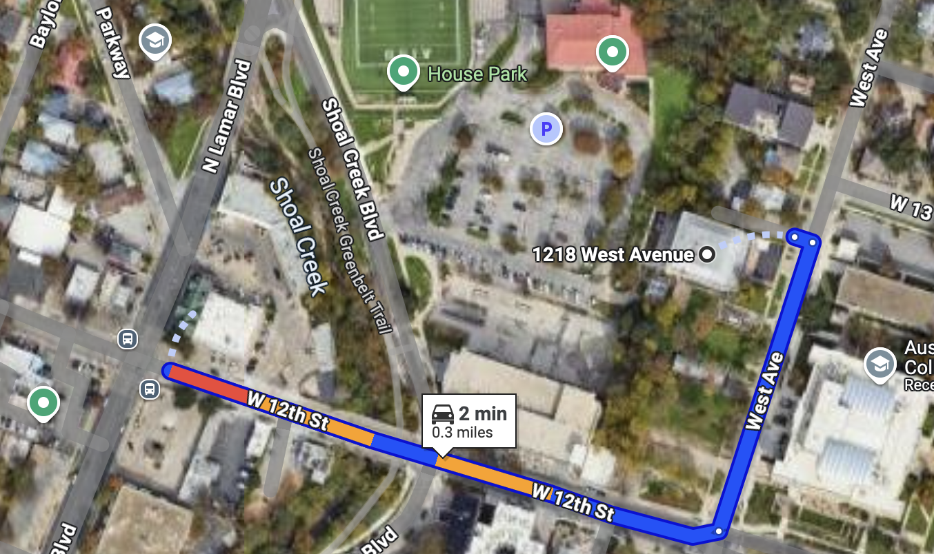
RGC-3000 and Tavern After Party
Website: aimug.org – All things LangChain and AIMUG.
Discord: Join us for ongoing conversations.
GitHub: Austin LangChain Repo – Check out our open-source projects.
Meetup: Austin LangChain Group
Twitter: @AustinLangChain – Latest updates and AI news.
YouTube: Austin LangChain Channel – Watch replays and tutorials.
ACC RGC3000
The Tavern
ACC Main Campus

Slide 23


Slide 24
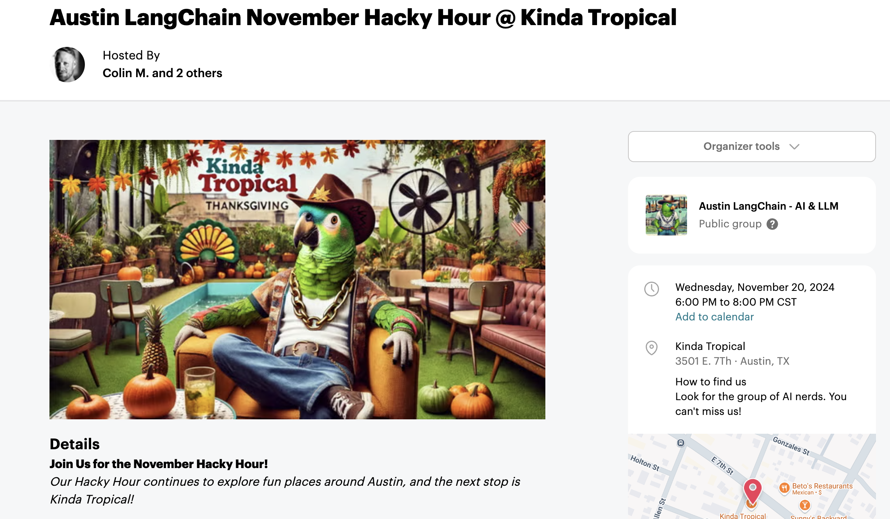

Next Event – Hacky Hour at Kinda Tropical
Respect & Inclusivity: Our only rule is simple: “Be cool to each other, don’t be gross.”
AI Enthusiasts of All Levels Welcome: We celebrate diverse perspectives and unique paths in AI.

